Slide 1
Coding
One teacher’s journey

Slide 2
I love coding. Sometimes you have to problem solve to get it to work but when you do you have a little party in your head!
Rachael – stage 3
My experience coding…

Slide 3
My class

Slide 5
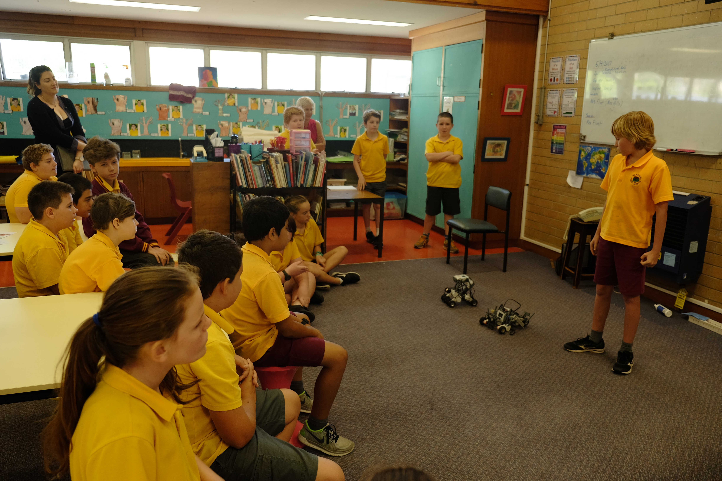

Slide 6
My journey with Coding
Scratch
Robotics - Edisons – girls can code – spheros -Lego Mindstorm - Makey Makeys - Python (Gats kids/teacher)
Genius hour
Maker space
Sharing with other staff/our stage/Practicum students – coding – running a lunch time club in the library
Visual programming, also known as block-based programming, is a coding language. This type of language allows kids to create programs by manipulating elements graphically rather than writing in text format.

Slide 7
Top teacher tips
Learn with the kids
Ditch the uniformity
Encourage collaboration
Its okay to ask for help from the kids.
Model what it is like not to know everything.
Learn in small chunks.
Plan B if it doesn’t go according to plan.
Set time limits/frequent small amounts/occasional longer time.
Genius hour – find examples to inspire the kids.
Students learn at different rates.
Technology code of conduct. Revise appropriate conduct and consequences of inappropriate choices.
Approved activities or ways of extending the task if finished whole class task.
It’s okay to play.
Self and peer assessment.
Kids referencing others in their projects.
Debrief at the end.
Share ‘what a good one looks like’.

Slide 8
What do I teach the kids?
https://www.australiancurriculum.edu.au/f-10-curriculum/technologies/digital-technologies/
Band description
Content description
Learning area achievement standard
Work samples

Slide 9
Australian Curriculum: Technologies (F-10) Future proofing – based on a framework of thinking
Two subjects – Digital and design technologies - Both subjects provide opportunities for students to create solutions and develop a range of thinking skills, including;
Design thinking
Systems thinking
Computational thinking
creative and critical thinking are also highly relevant. Be prepared to learn alongside the kids. This makes for an exciting, Transformative classroom, you learn more interesting things in the process. Express and explore ideas.

Slide 10
Australian Curriculum: Technologies (F-10) Both subjects provide opportunities for students to create solutions and develop a range of thinking skills.
Subject - Digital Technologies
Two strands – Digital systems and representation of data
Deeper skills in digital technologies: Processes and production skills - Focuses on the how.
Transferable Knowledge and skills, disposition
General capabilities – trying to work holistically - Multimedia is taught across all KLAs (DT focuses on the skills required.)
Subject - Design technologies
Learn how to manage projects – design something for a specific purpose.
Collaborate and communicate
Creative thinking
Consider the impact of tech in the future

Slide 11
Great websites that helped me
Australian computing academy
Also good PD on 10 key concepts underpinning syllabus
https://aca.edu.au/#home-unpack

Slide 12
Great websites that helped me
Digital technologies: What are they for?
Browse topics by resources
Coding in the classroom
https://www.youtube.com/watch?v=CrL8lqJkvAE
Good animation
https://www.digitaltechnologieshub.edu.au/teachers/topics
https://www.edutopia.org/topic/coding-classroom

Slide 13
NESA
Very cool definitions and links
https://educationstandards.nsw.edu.au/wps/portal/nesa/k-10/learning-areas/technologies/coding-across-the-curriculum/stage-3

Slide 14
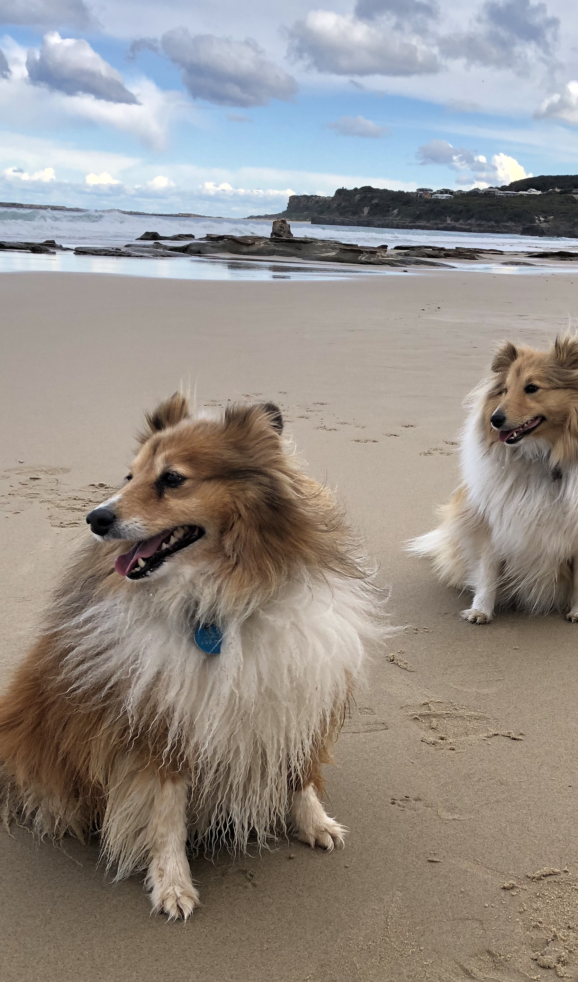
References
https://www.youtube.com/watch?v=AeVqu73a89A
https://aca.edu.au/#home-unpack
Code.org complete curriculum

