Slide 1
Visual Programming
with Scratch

Slide 2
Session Schedule
Visual Programming & the Digital Technologies Curriculum
What is Visual Programming?
Visual Programming Examples
Scratch Activity

Slide 3
Visual Programming & the DT Curriculum
Visual programs are referred to a few times in the DT Curriculum Outline¹
In Years 3 and 4 Content Descriptions: “Implement simple digital solutions as visual programs with algorithms involving branching (decisions) and user input (ACTDIP011)”
In Years 5 and 6 Content Descriptions: “Implement digital solutions as simple visual programs involving branching, iteration (repetition), and user input (ACTDIP020)”
In Years 7 – 10, students will move onto implementing digital solutions in a general-purpose programming language (e.g Python)

Slide 4
What is Visual Programming?

Slide 5
What is Visual Programming?
“any programming language that lets users create programs by manipulating program elements graphically rather than by specifying them textually”²
They often use visual metaphors, such as:
Fitting puzzle pieces together (Scratch³, Blockly Games⁴)
Flowcharts (e.g. Flowgorithm⁵)
Allow students to create programs without knowing coding syntax or concepts that are specific to certain languages
Some of them can be run through a web browser, with no need to install any software (e.g. Blockly Games and Scratch)

Slide 6
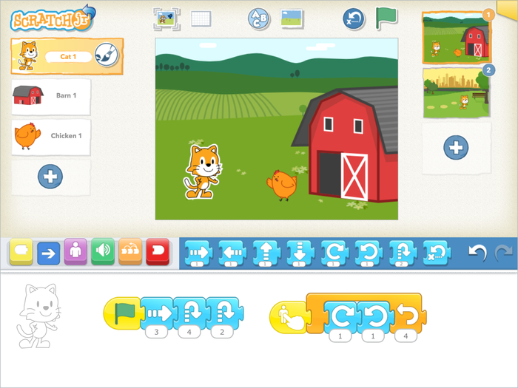
Visual Programming Examples
Scratch Jr⁶
For young children (5 – 7 year olds)
A simpler version of Scratch
Available on iOS and Android

Slide 7
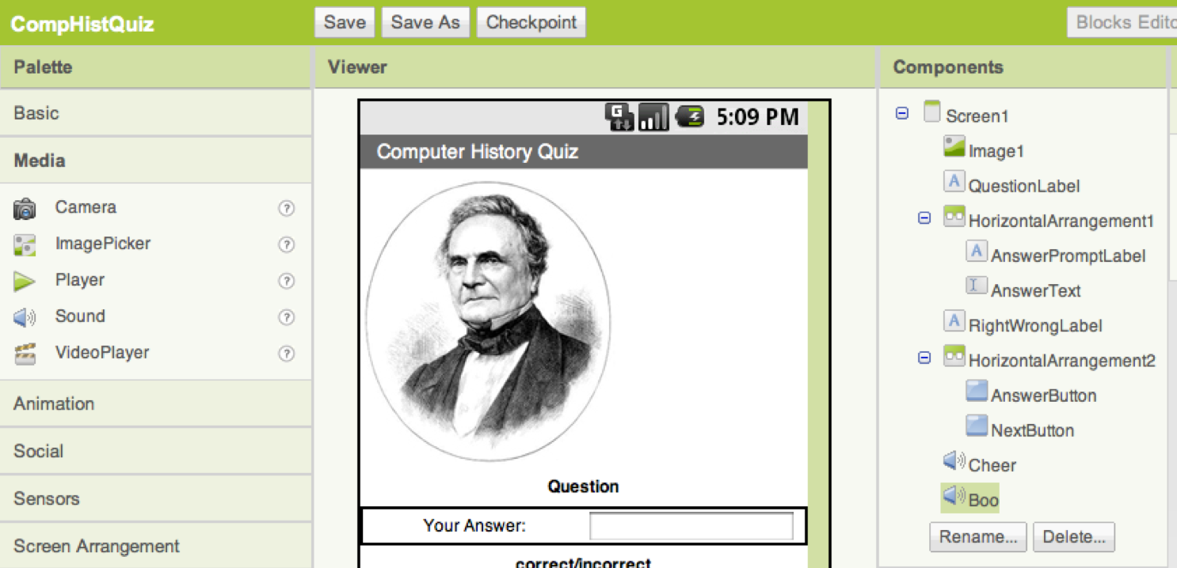
Visual Programming Examples
AppInventor⁷
Software to build Android apps using Visual Programming
Runs in a web browser (e.g. Firefox or Internet Explorer)
You don’t need even need an Android tablet or phone to use it!

Slide 8
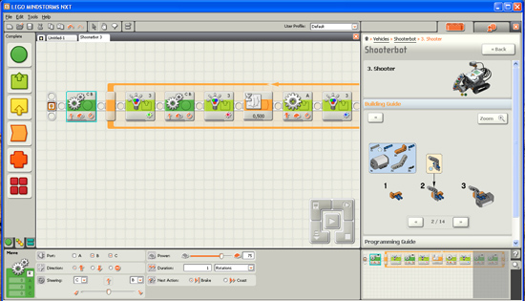
Visual Programming Examples
LEGO Mindstorms⁸
Programmable and modifiable robots made with lego
Can use sensors, e.g:
Temperature
Volume
Touch

Slide 9
Scratch Activity
In this session we will be using Scratch to make a game
Scratch can be used through a web browser
It can also be downloaded and run offline
Created games and animations can be shared and remixed
There is a huge community and number of resources for Scratch

Slide 10
Scratch Activity
There are two step-by-step activities in this session:
A quick introduction to Scratch
Making a game (called Cookie Bird) with Scratch
The resources for the Cookie Bird activity are available online, the link for these is on the worksheet

Slide 11
References
1. Digital Technologies Curriculum – ACARA
http://www.australiancurriculum.edu.au/technologies/digital-technologies/curriculum/f-10?layout=1
2. Visual programming language – Wikipedia
https://en.wikipedia.org/wiki/Visual_programming_language
3. Scratch - https://scratch.mit.edu/
4. Blockly Games - https://blockly-games.appspot.com/
5. Flowgorithm - http://www.flowgorithm.org/
6. Scratch Jr - http://www.scratchjr.org/
7. AppInventor - http://appinventor.mit.edu/explore/
8. LEGO Mindstorms
http://www.lego.com/en-us/mindstorms/?domainredir=mindstorms.lego.com

